Slide 1
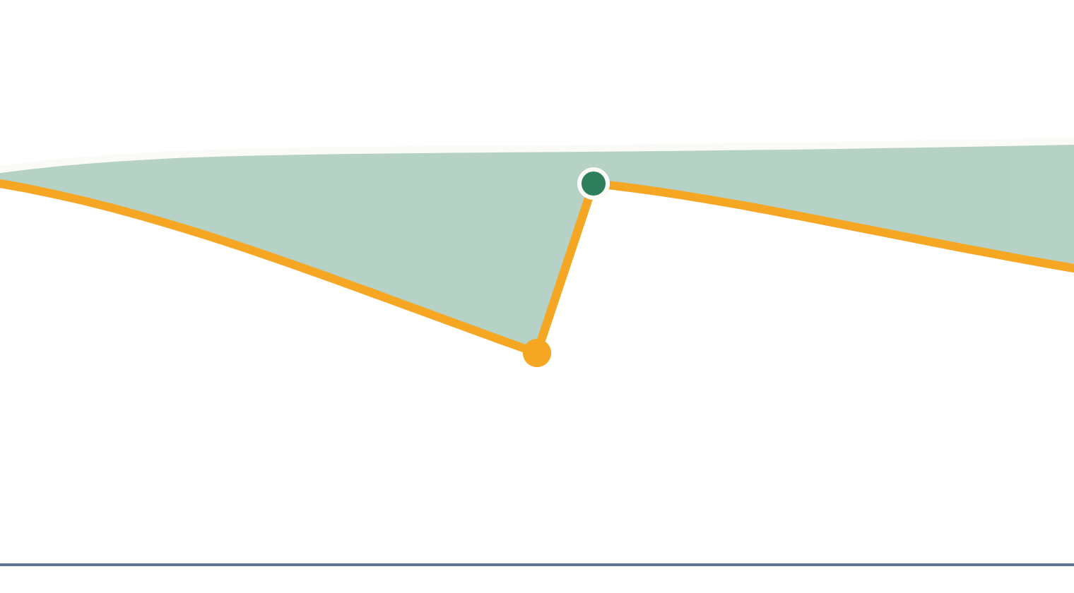
TrueYield
SANKALP BY SFL · THE CLIMATE EDITION 2026
Independent verification of how much energy a rooftop solar system loses, and how much a fix wins back.
Student Track · Theme: Clean Energy
Raghav Rege · B.Tech CSE, 3rd year
SRM Institute of Science and Technology · raghav.rege@gmail.com
Notes:
[VIDEO 0:00 to 0:15]
I'm Raghav Rege, a third-year computer science student at SRM Institute of Science and Technology. This is TrueYield: an independent check on how much energy a rooftop solar system is losing, and how much a fix wins back.

Slide 2
Small solar systems lose output quietly, and owners cannot see it
PROBLEM:
1. A small business installs rooftop solar
10–20%
Often on a loan, expecting a steady saving on every bill.
2. Dust, shade and faults build up
Free maintenance usually excludes cleaning and is mostly reactive.
more energy after a single cleaning, in field tests on 61 Delhi rooftops
3. Savings shrink without warning
No independent record shows what the system should be producing.
Soiling was found at about 80% of the sites tested
The panels still work, so nobody notices the loss.
Sources: CEEW 2023 [1], CEEW 2026 [2]
2 / 8
Notes:
[VIDEO 0:15 to 0:40]
A small business puts solar on its roof, often on a loan. Then dust, shade and faults build up, and the savings shrink without anyone noticing. Field tests on Delhi rooftops found ten to twenty percent more energy after a single cleaning. The panels still work, so nobody sees the loss. And no neutral record says what the system should be producing.

Slide 3
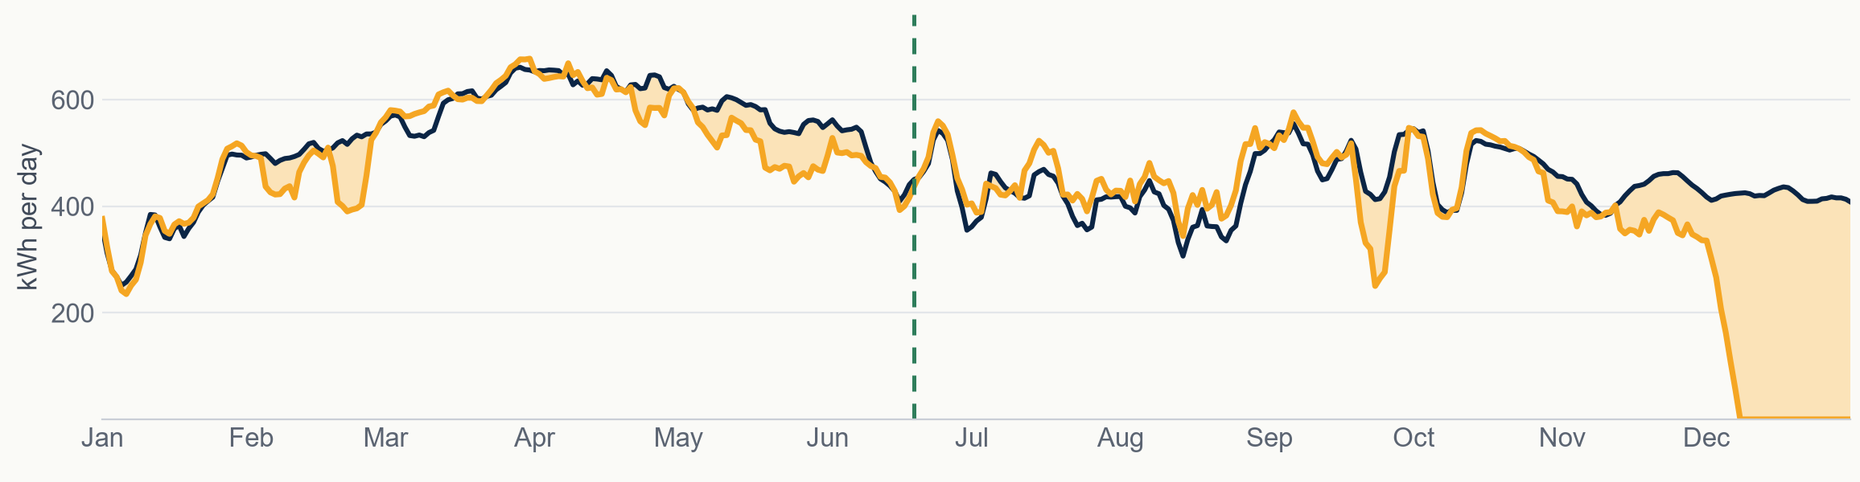
One loop: verify the loss, explain it, and prove the recovery
SOLUTION:
1
2
3
4
5
6
7
Input
Normalise
Detect
Explain
Advise
Verify
Report
Expected output
Actual output
Lost energy
Public dataset: Jaipur rooftop plant, 2022 [9]
Heavy rain, 19 June: output up 14% (range 6–22%)
Zero output, 5 to 31 December: breakdown
No new hardware where the inverter already records generation
3 / 8
Notes:
[VIDEO 0:40 to 1:10]
TrueYield works as one loop. It takes the inverter's own data and free satellite weather, works out what the system should have produced, and measures the gap, always with a range. This chart is real data from a rooftop plant in Jaipur in 2022. Navy is expected output, amber is actual. The gap in December is a twenty-seven day breakdown. The gap in May and June closes after heavy rain on the nineteenth of June.
[NEXT: slides 4 and 5 are optional. If you skip them, switch to the terminal and the app now. The demo narration is in the notes of slide 5.]

Slide 4

A transparent pipeline from inverter data to an auditable report
ARCHITECTURE AND TECH STACK:
Data sources
Inverter data · site details · weather
Layer | Tech stack | Phase
Data | Python, Pandas | 1
Weather | NASA POWER | 1
Yield model | pvlib, calibrated | 1
Detection | Statistics, ranges | 1
Reports | Python PDF, CSV | 1
Backend | FastAPI | 2
Database | PostgreSQL | 2
Dashboard | Streamlit, React | 2
Ingestion
Clean, align and gap-check time series
Core engine
Expected yield → performance ratio → loss with range → likely cause → cost of fix
Verification
Before/after recovery around a dated event
Outputs
Owner alert · ranked list · recovery report
Phase 1 is the submission prototype. Not used: deep learning or an LLM for diagnosis, or blockchain.
Data store: measurements, site details and dated events
Tools: pvlib [6], NASA POWER [7]
4 / 8
Notes:
[OPTIONAL, about 15 seconds. Skip this slide if the video runs over 4 minutes.]
The architecture is a straight pipeline: clean the inverter data, model the expected yield, estimate the loss with a range, suggest a likely cause, and verify recovery around a dated event. It is built in Python with pvlib and NASA weather data.

Slide 5
The gap is independent, uncertainty-aware verification for small systems
INNOVATION:
What exists
What is missing
What I add
Monitoring, fault alerts and yield estimates, sold by installers and hardware makers.
A neutral record of lost and recovered energy that states how sure it is.
Explainable loss estimates with ranges, and measured recovery after a dated fix.
Option | Cross-brand | Independent | States range | Verifies fix | Small systems
Inverter-brand apps | No | No | ? | ? | Yes
Jio SunGenie (gateway) | Yes | ? | ? | ? | Yes
Installer guarantee (SolarSquare) | No | No | ? | ? | Yes
TrueYield (design goal) | Yes | Yes | Yes | Yes | Yes
? = not confirmed from public product pages [8]. To be verified.
5 / 8
Notes:
[OPTIONAL, about 15 seconds. Skip this slide if the video runs over 4 minutes.]
Solar monitoring already exists, sold by installers and hardware makers. What is missing is a neutral record of lost and recovered energy that says how sure it is. That is what I add.
[NOW SWITCH TO THE DEMO. VIDEO 1:10 to 2:50 if slides 4 and 5 were skipped.]
[Terminal, showing the finished run] Here is the working prototype. One command runs the whole pipeline. The input is one year of daily energy readings from a 120 kilowatt rooftop plant in Jaipur, a public dataset, together with satellite weather from NASA. Nothing is trained: there is no machine learning here. Each system is compared against its own best performance.
[App, Jaipur selected, top of the page] In the viewer I choose the Jaipur system. Every screen carries a data label, so it is clear this is not my own system. The estimated loss is 8.4 percent, with a range of 6.5 to 9.2, about fourteen thousand nine hundred kilowatt-hours. The tool never shows a loss without its range. It also states its detection limit: on this data, anything under about nine percent over two weeks cannot be told apart from noise, so it is not claimed.
[App, scroll to the second chart] This chart shows performance against the system's own best. Shaded bands are sustained shortfalls, green lines are heavy rain, and the crosses are days of zero output in good sun.
[App, open 'outage or fault', then 'soiling'] Under likely causes, facts and hypotheses are kept apart. Outage: twenty-nine days of near-zero output, which is a fact. Soiling: tested, and not distinguishable from scatter, so the tool says so instead of guessing.
[The Jaipur PDF report, page 1 then page 2] Each system also gets a two-page report that an owner, installer or lender can audit: what was measured, what was estimated, how sure, and the limits. It is physics and statistics only. No machine learning and no language model is used in the analysis.
[Return to the deck at slide 6.]

Slide 6
Impact is measured in kWh recovered, before and after a dated fix
IMPACT AND VALIDATION:
What we have built
How we measure impact
1 rooftop system in Jaipur, Rajasthan: 12 months of daily data (2022)
Detected loss: 8.4% (range 6.5–9.2%), about 14,900 kWh, most of it a 27-day breakdown in December. Rupee value: not available without a tariff
Recovery test planned: one dated panel cleaning on an Indian rooftop, comparing 14 clear days before and after
Data: public dataset, not our own system [9]
Detection limit: about 9% over 14 days. Smaller losses are not claimed
Baseline: weather-adjusted output before the fix
Event: a dated cleaning, repair or heavy rain
Result: change in output, with a range
Emissions = kWh recovered × grid emission factor [5]
Claimed today: estimated loss. Not yet: energy recovered.
Method check [10]: on 4 years of public data from 3 Las Vegas systems, 85% of a known injected loss was recovered, inside the stated range. On the one-year Jaipur data the same check did not pass, so those figures are coarse.
ILLUSTRATION, NOT A RESULT
A 50 kW rooftop at 15% capacity use yields about 65,700 kWh a year. Recovering a 15% loss returns about 9,900 kWh and about 7.5 tonnes of CO2 a year.
Illustration uses the capacity-use benchmark and emissions figure in CEEW 2026 [2]
6 / 8
Notes:
[VIDEO 2:50 to 3:25]
What can I honestly claim today? An estimated loss, on public data. Most of the Jaipur loss is that December breakdown, which the dataset's authors also report, so the tool found it independently. I tested the method by injecting a known loss into four years of data from three systems in Las Vegas: it recovered eighty-five percent, inside its stated range. On one year of Jaipur data that check did not pass, so those figures are coarse. A real cleaning test, before and after, is planned and not yet done.

Slide 7
A clear first user, a path to scale, and risks we already know
ADOPTION, SCALE AND RISKS:
Who uses it, who pays
Risks and our response
Team and Ask
Users: small commercial rooftop owners and their installers, one city first
Payer, to be validated: installer per system, or lender per asset
Scale: software only, across inverter brands
Weather-data error can hide small losses: every figure carries a range
Inverter data access: start with brands that export data
Free basic alerts elsewhere: we verify, not just monitor
Raghav Rege, B.Tech CSE, 3rd year, SRM Institute of Science and Technology (solo entry)
Ask: mentorship, pilot rooftops and data partners
FUTURE USES OF THE SAME RECORD
Lender view of financed solar · results-linked maintenance · idle solar pumps · savings checks on efficiency loans
Business model is a hypothesis; interviews follow the submission
7 / 8
Notes:
[VIDEO 3:25 to 3:50]
The first users are small commercial rooftop owners and their installers. It is software only and needs no new hardware where the inverter already records generation. The business model is still a hypothesis. My ask is mentorship, pilot rooftops and data partners, so the next result is a measured recovery on an Indian roof.

Slide 8
Every figure in this deck traces to a source
REFERENCES:
CEEW (Nov 2023). kWh from kW: Achieving Optimum Energy Generation from Rooftop Solar Systems. ceew.in
CEEW (Jun 2026). Maximising Rooftop Solar Performance by Enabling a Robust O&M Ecosystem. ceew.in
MNRE. PM Surya Ghar progress figures, as reported August 2026. [verify]
CRISIL and Bridge to India. Rooftop Map, June 2025, as reported by Solar Quarter.
Central Electricity Authority. CO2 Baseline Database for the Indian Power Sector. cea.nic.in
pvlib python. Open-source solar modelling library. pvlib-python.readthedocs.io
NASA POWER. Solar and meteorological data. power.larc.nasa.gov
Public product pages: Jio SunGenie, SolarSquare, inverter-brand apps. [verify]
Parashar, B. and Verma, R. (2024). Solar Panel Data (rooftop plant, Jaipur). Mendeley Data, V1. doi:10.17632/82jswfyz5p.1. CC BY 4.0.
Deline, C. et al. (2021). Photovoltaic Data Acquisition (PVDAQ) Public Datasets. NREL, OEDI. doi:10.25984/1846021. CC BY 4.0.
8 / 8
Notes:
[VIDEO 3:50 to 4:00]
Every figure here traces to a source. Thank you.

